Slide 1

Group 7
SQL Capstone Project
Analysis of DermAI Diagnostics Skin Cancer Dataset
AMADI JERRY

Slide 2

Background Information/Facts
There are 1,088 distinct patients in the Patients_Info Table (Table 1)
Similarly, there are also 1,088 lesion IDs in Lesion_Info Table (Table 2)
There are six (6) types of Skin Lesions/Cancers affecting patients from the dataset
They are: ACK, BCC, MEL, NEV, SCC & SEK
All Patients from the given dataset have one type of the six (6) listed skin lesions/cancers
All Patients have one of the seven (7) types of skin pigmentation (i.e. the Fitzpatrick Skin Type)
The Fitzpatrick scale is a system used to classify skin types based on their pigmentation and response to ultraviolet (UV) radiation.
The scale ranges from 0 (Very Very Fair Skin) to Type 6 (Deeply pigmented Brown or Black Skin)

Slide 3
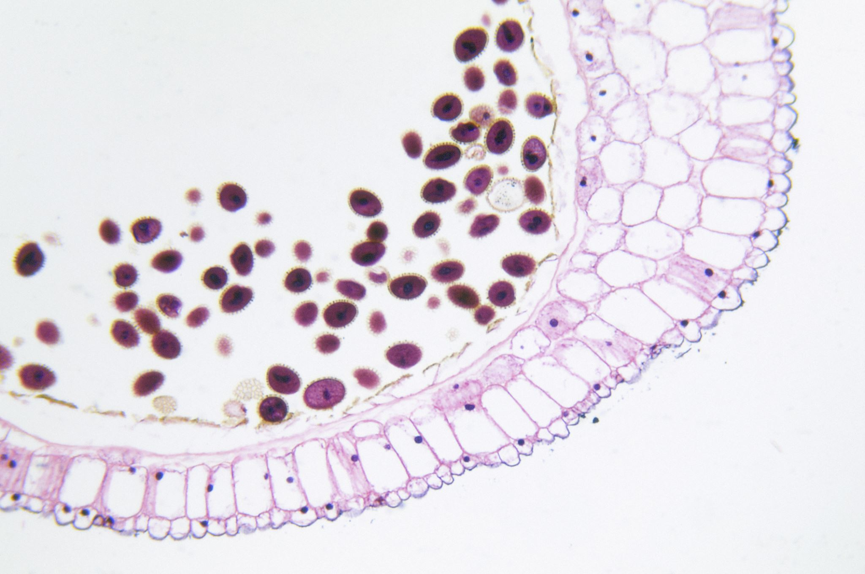
Key Facts on Skin Lesions
According to The American Academy of Dermatology, skin lesions are either Benign or Malignant skin cancers.
Benign skin lesions are non-cancerous growths that typically do not spread to other parts of the body as they tend to remain confined to their original location. They are generally harmless and may only require observation or cosmetic treatment.
Examples are:
NEV – Nevus (commonly known as moles)
SEK – Seborrheic Keratosis
Malignant skin lesions are cancerous and metastasizes to other organs and tissues through the bloodstream or lymphatic system. They can be life-threatening & terminal if left untreated. They grow rapidly and most times require aggressive treatment.
Examples are:
BCC – Basal Cell Carcinoma
SCC – Squamous Cell Carcinoma
ACK – Actinic Keratosis
MEL – Melanoma

Slide 4

Considerations In Analyzing The Dataset
What proportion of the patients from dataset have malignant skin cancers?
What factors/drivers predisposes patients to the malignant forms of cancers
Demographic Drivers (e.g. Ethnicity, Gender, Age and Skin Pigmentation)
Lifestyle Choices/Behaviors e.g. Smoking, drinking
Environmental Risk Factors e.g. Exposure to pesticides, access to piped water & sewage system
Characteristics of the Skin Lesions (e.g. Lesion Itches, Pain, Bleeding, Color & Size)
Medical History e.g. Previous Skin Cancer Diagnosis & History of Cancers in the Family
How would findings/data from the analysis enhance early-stage diagnosis?
Create a machine learning- ready data set to support early detection of skin cancers

Slide 5
Demographics Analysis on Severity of Skin Lesions
Analysis of Ethnicity, Gender, Age, Previous Skin Cancer Diagnosis & Family History in Relation to Skin Lesion Diagnostic Types

Slide 6
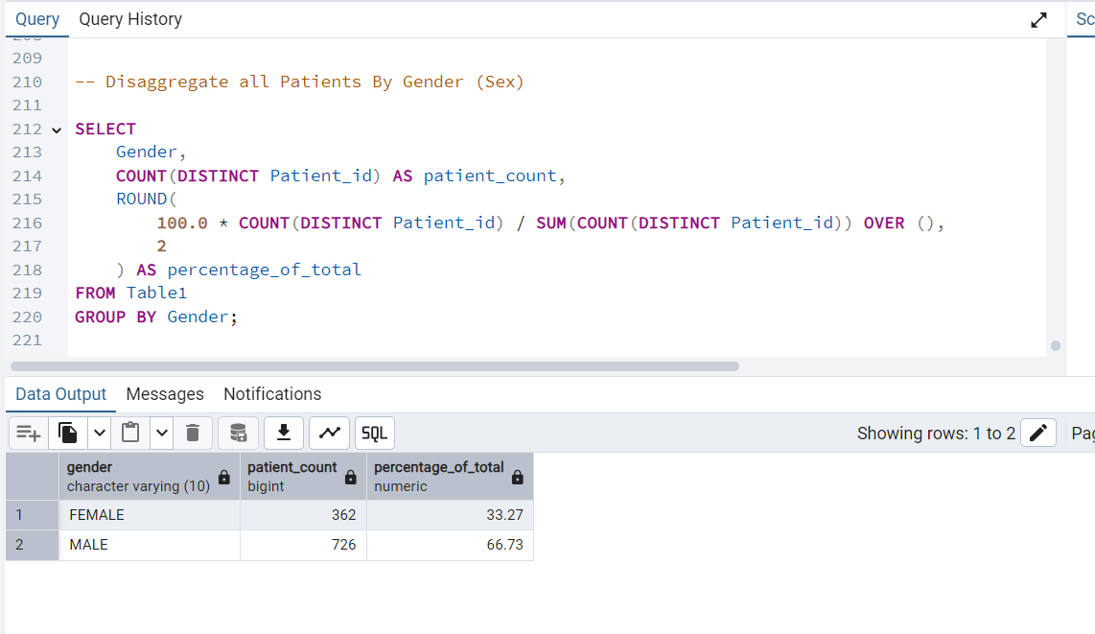

Slide 7
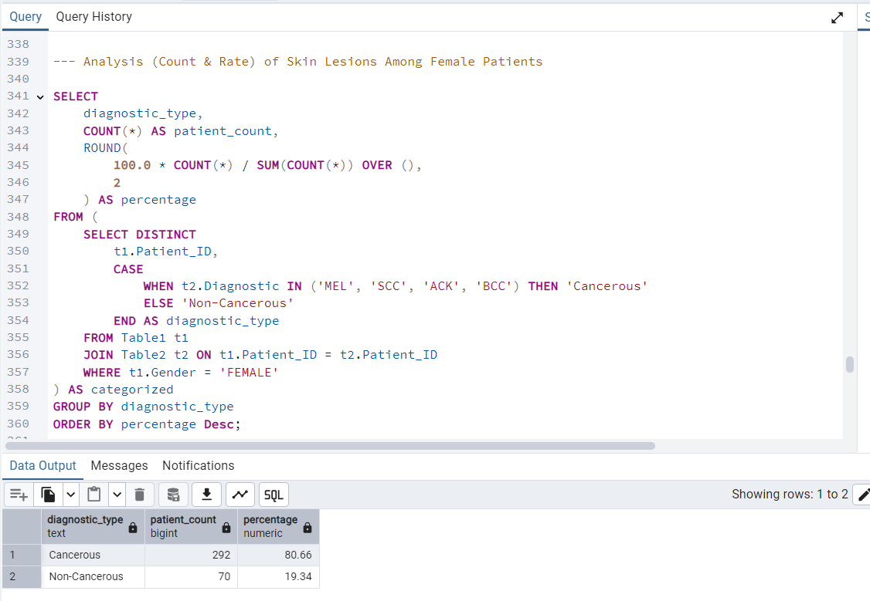

Slide 8
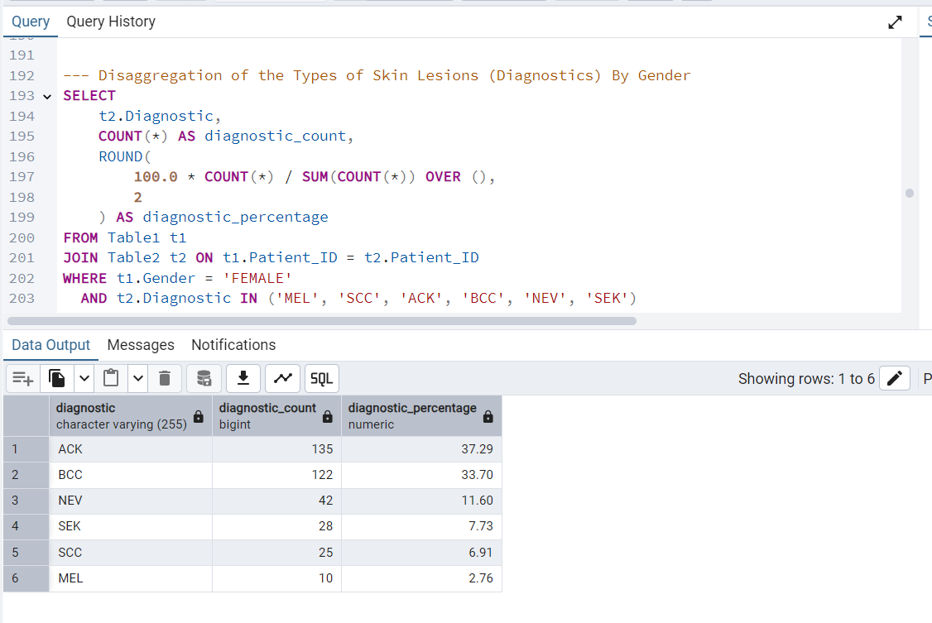

Slide 9
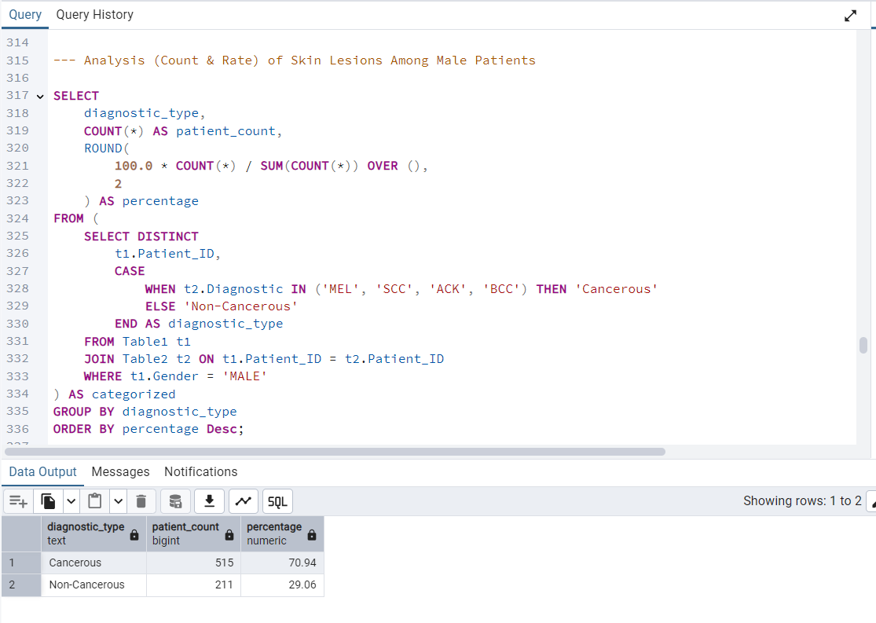

Slide 10
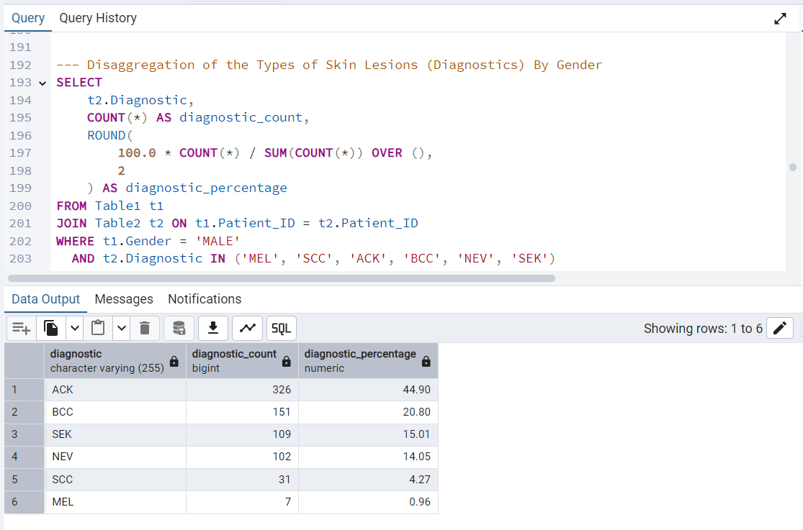

Slide 11
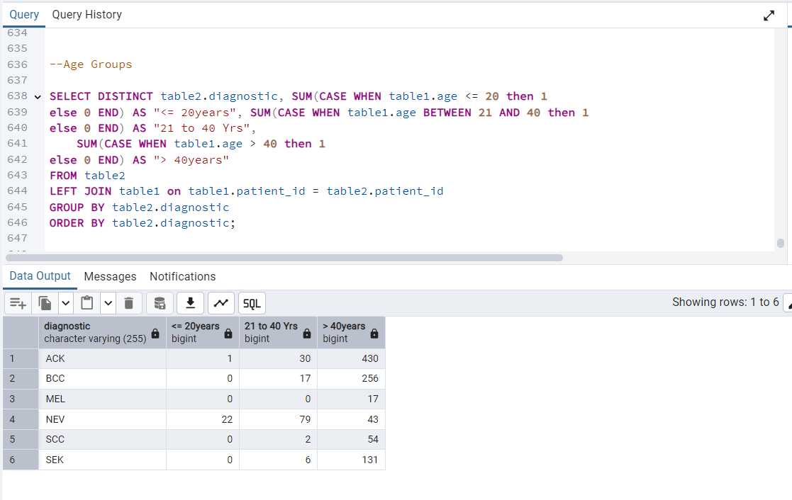

Slide 12
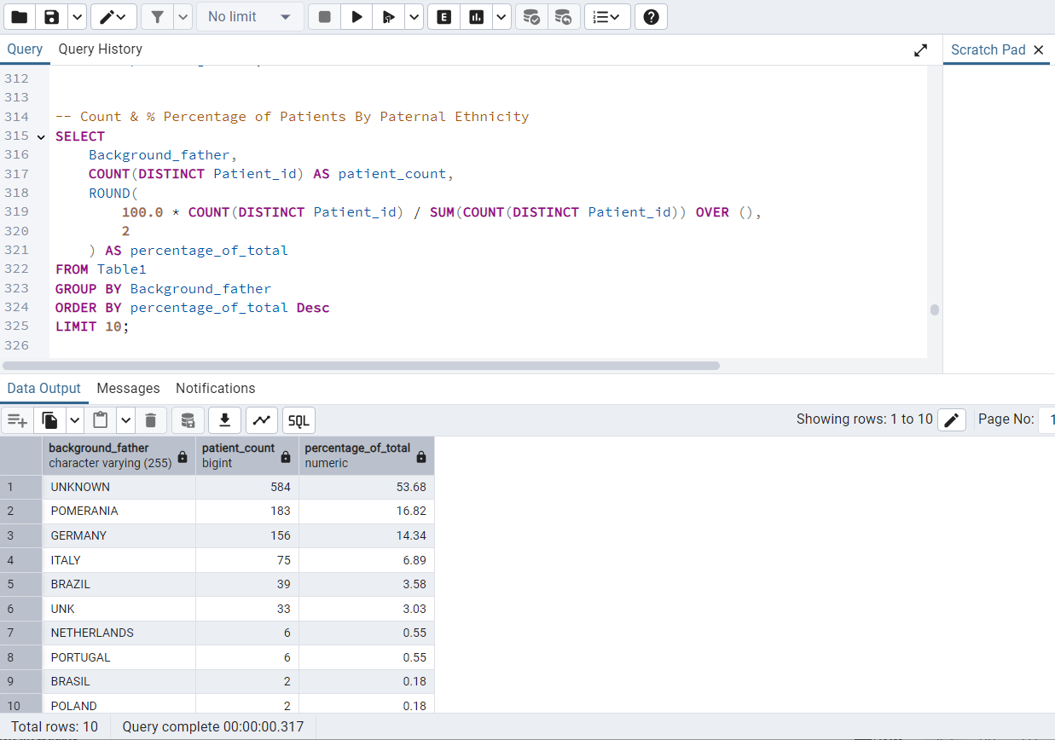

Slide 13
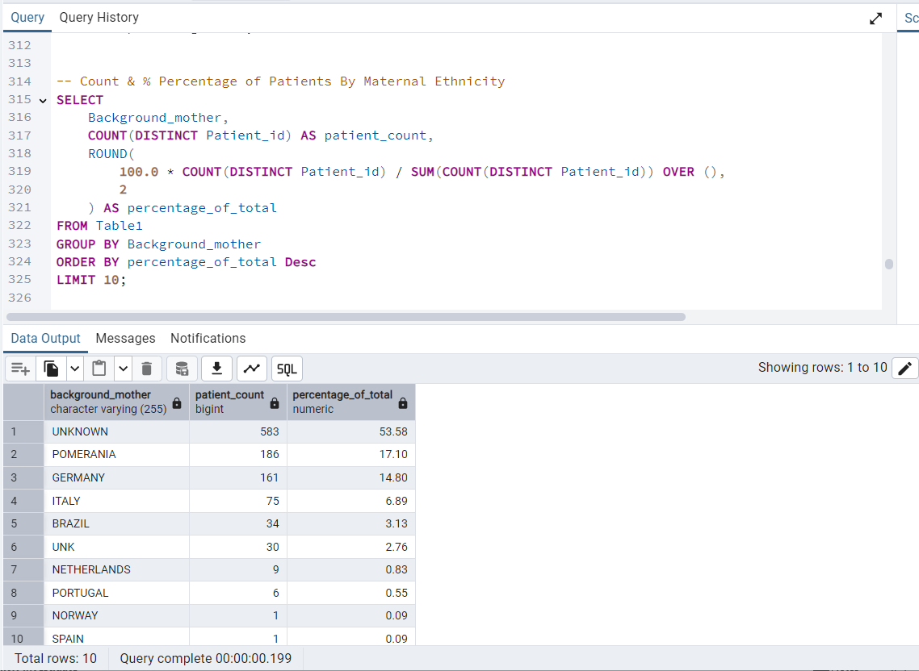

Slide 14
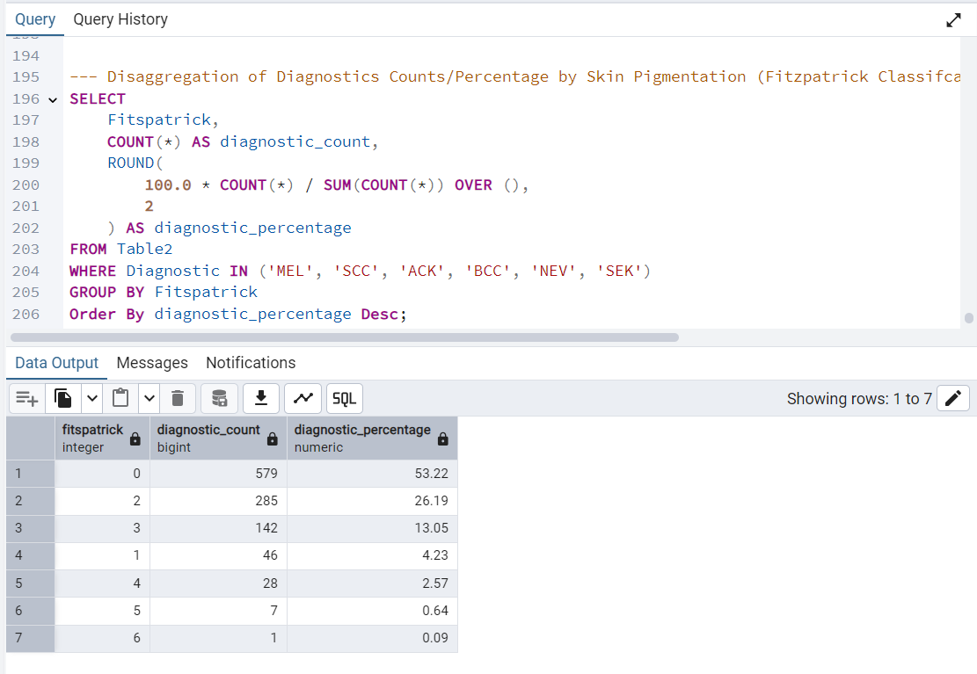

Slide 15
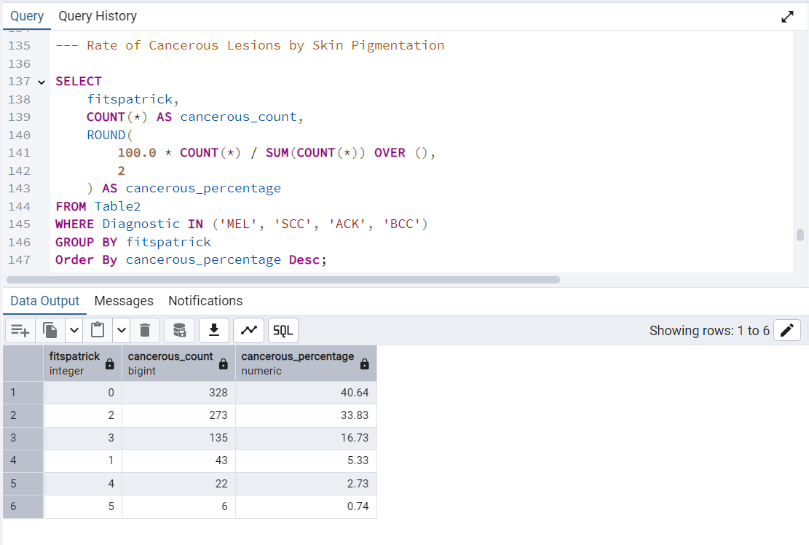

Slide 16
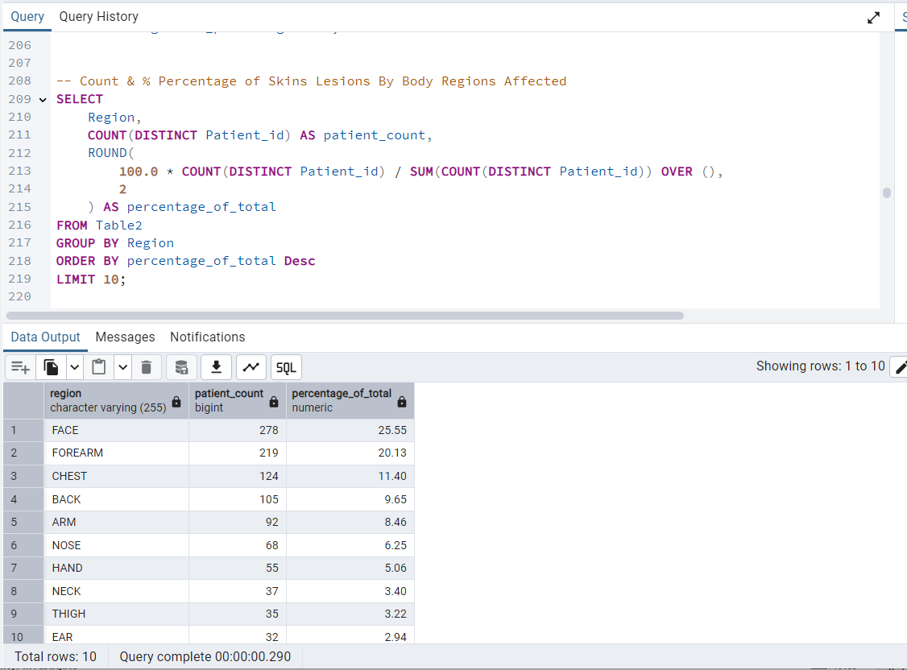

Slide 17
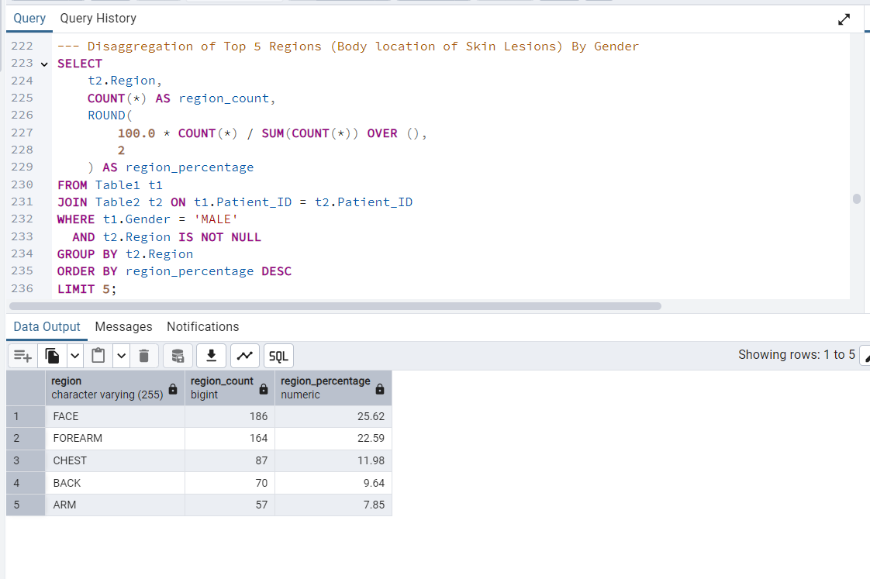

Slide 18
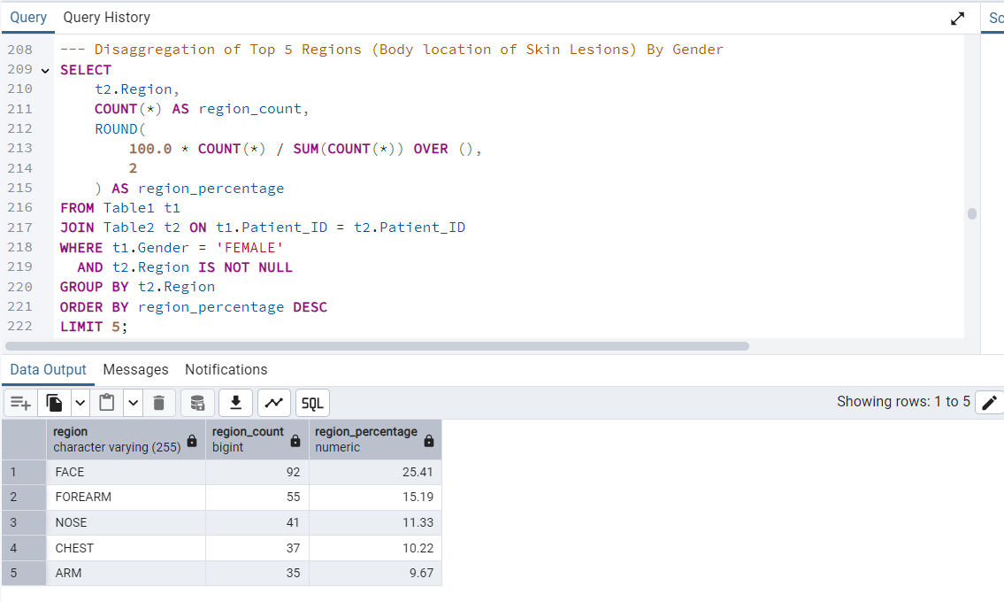

Slide 19

Effect of Lifestyle Choices on Severity of Skin Lesions/Cancers
Analysis of Smoking & Drinking in Relation to Skin Lesion Diagnostic Types

Slide 20
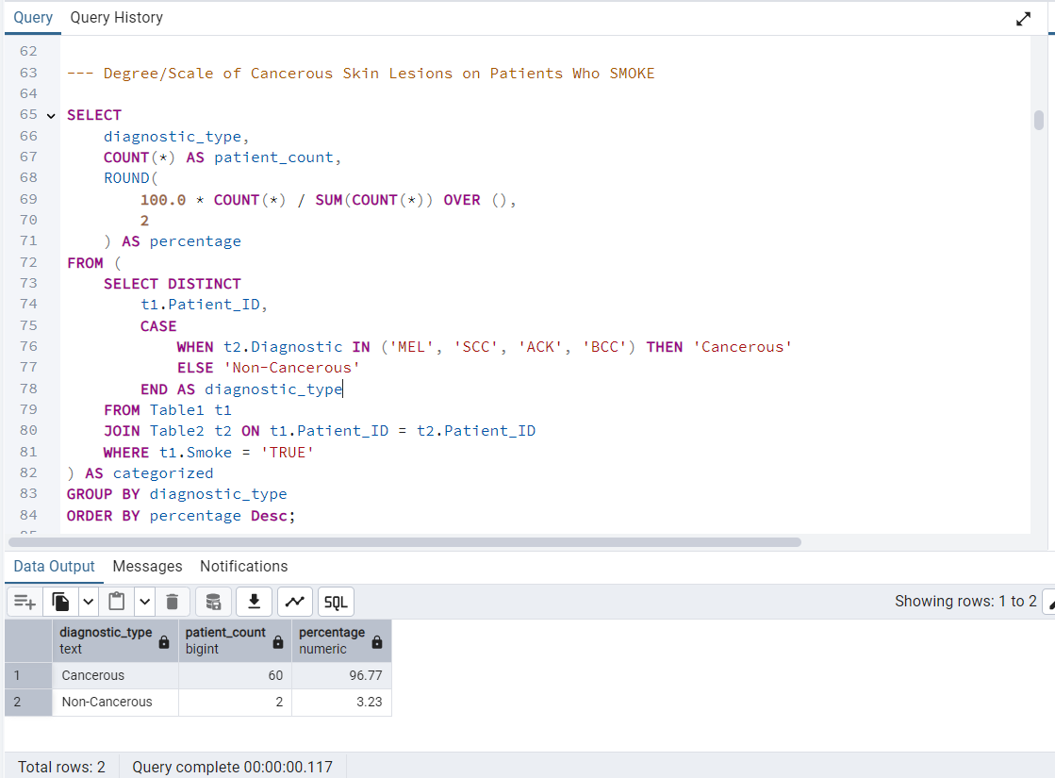

Slide 21
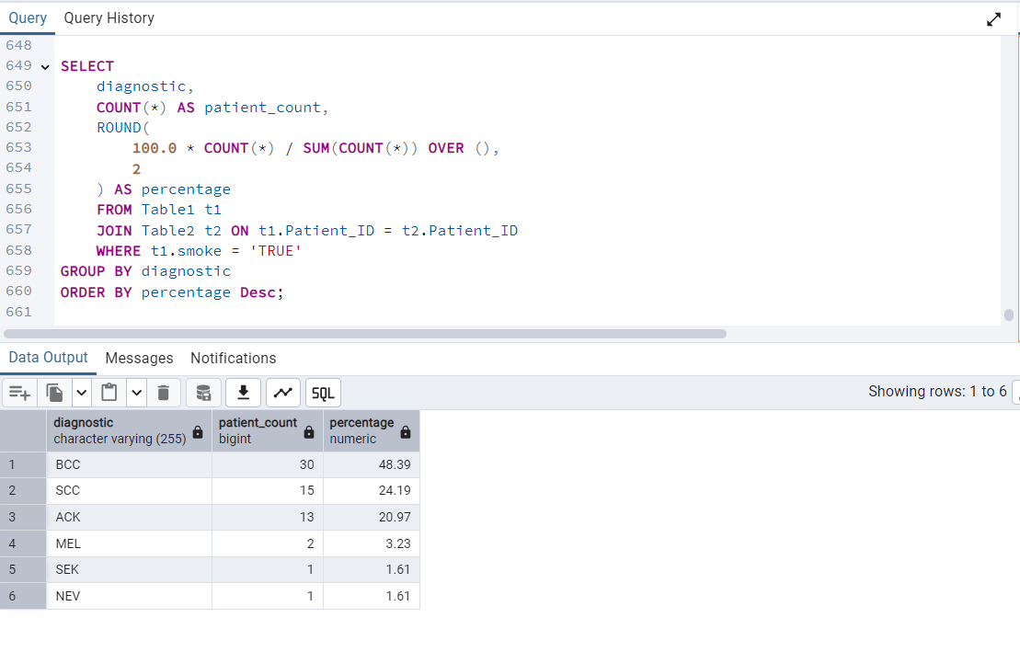

Slide 22
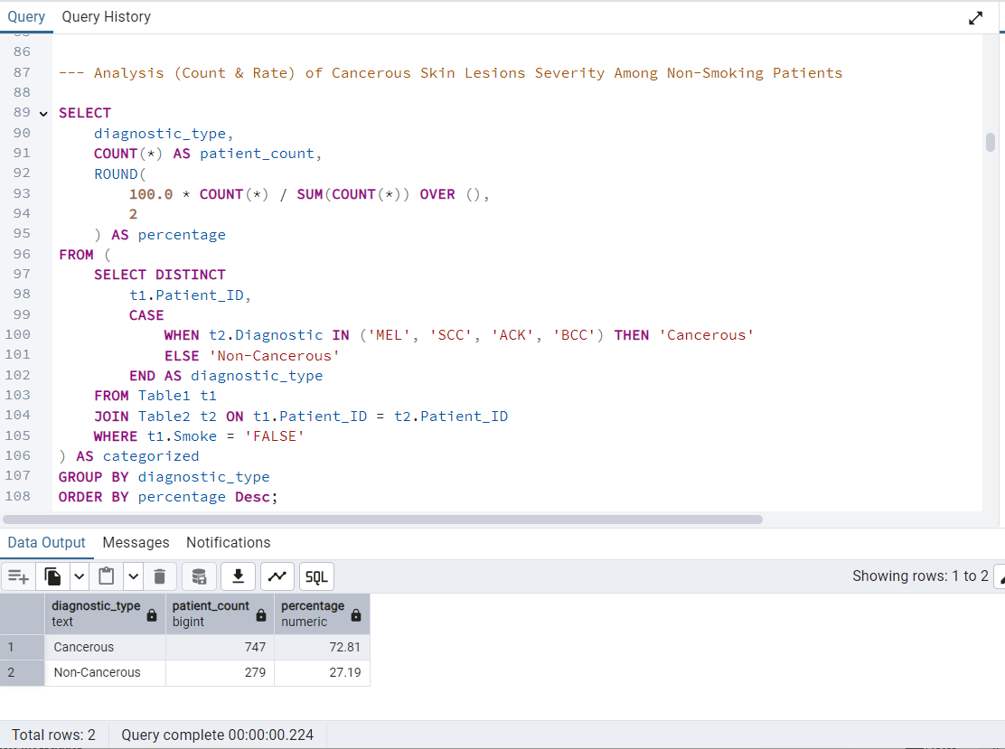

Slide 23
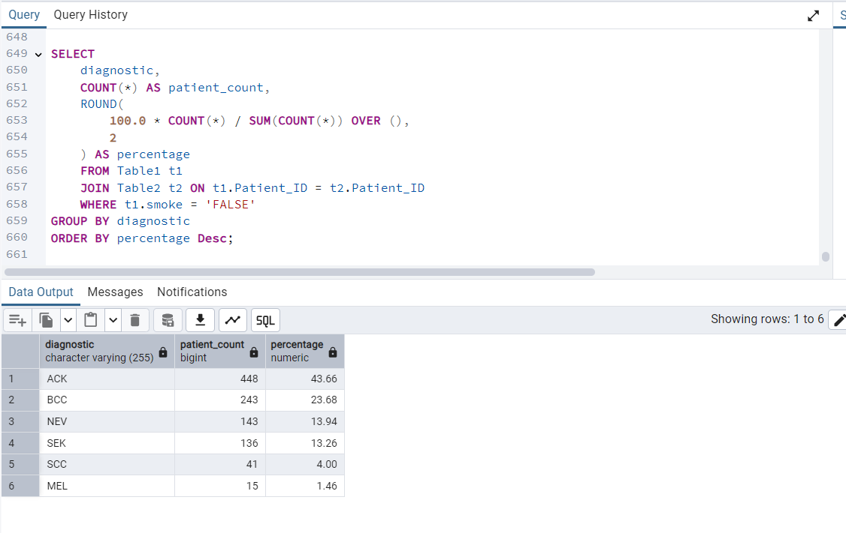

Slide 24
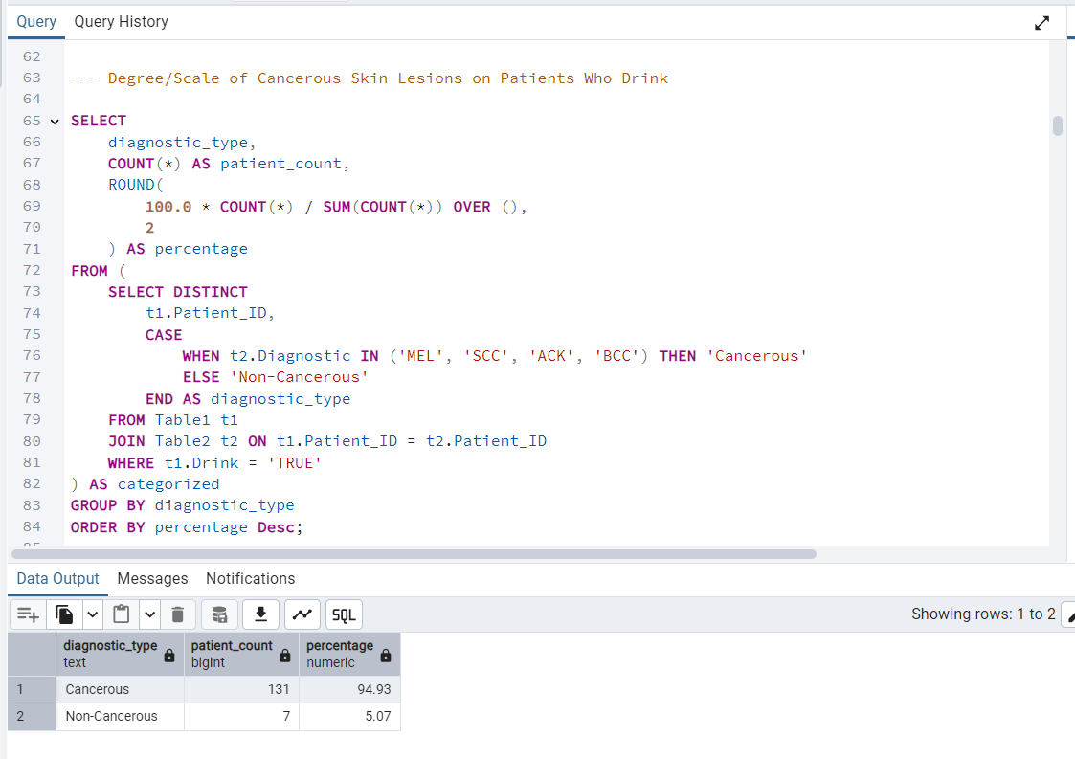

Slide 25
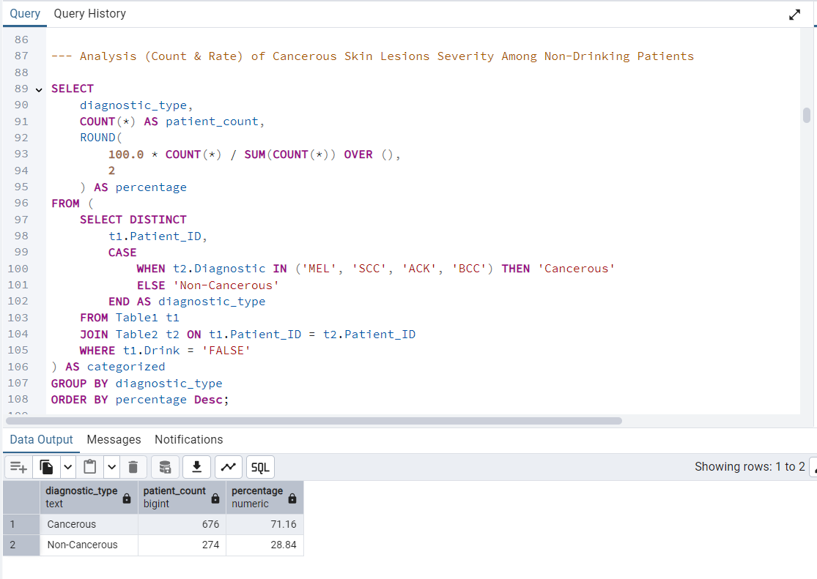

Slide 26

Environmental Exposure on Severity of Skin Lesions
Analysis of Exposure to Pesticides, Access to Piped Water & Sewage System in Relation to Skin Lesion Diagnostic Types

Slide 27
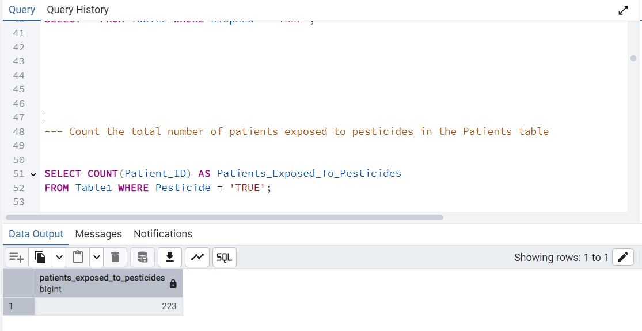

Slide 28
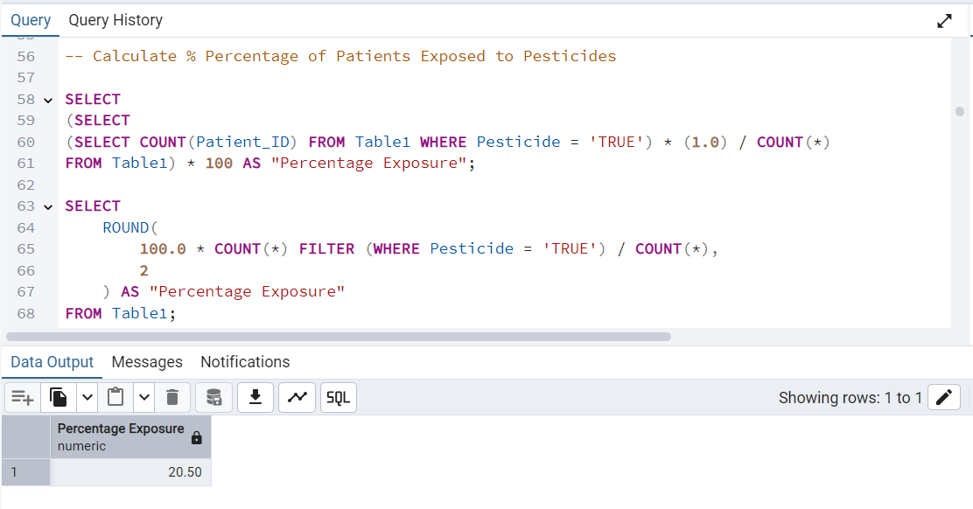

Slide 29
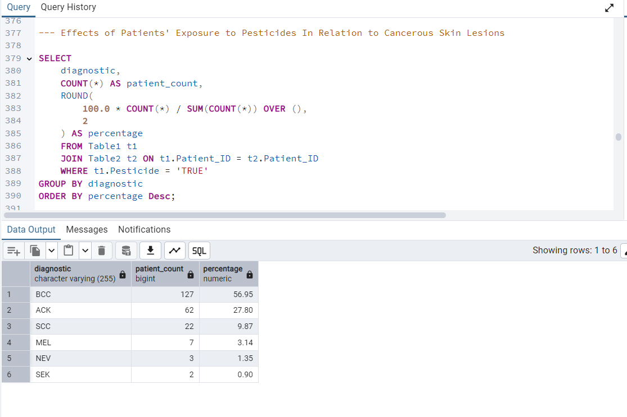

Slide 30
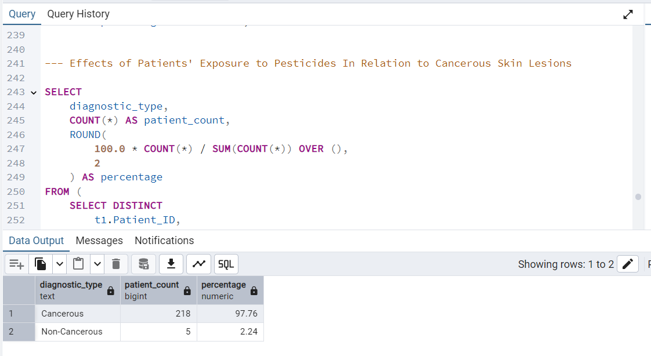

Slide 31
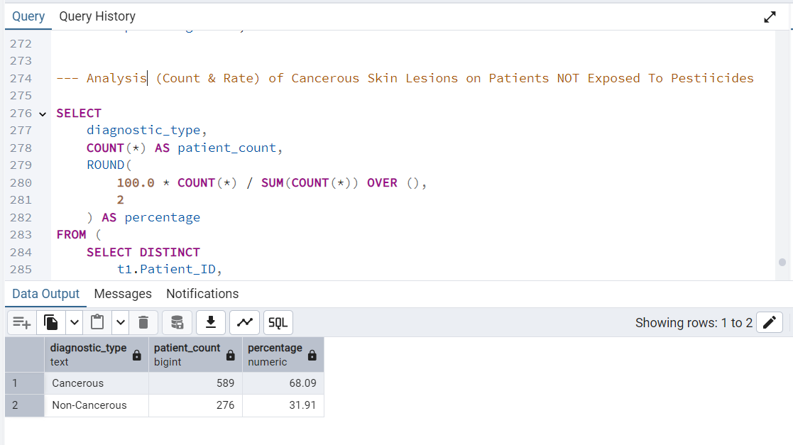

Slide 32
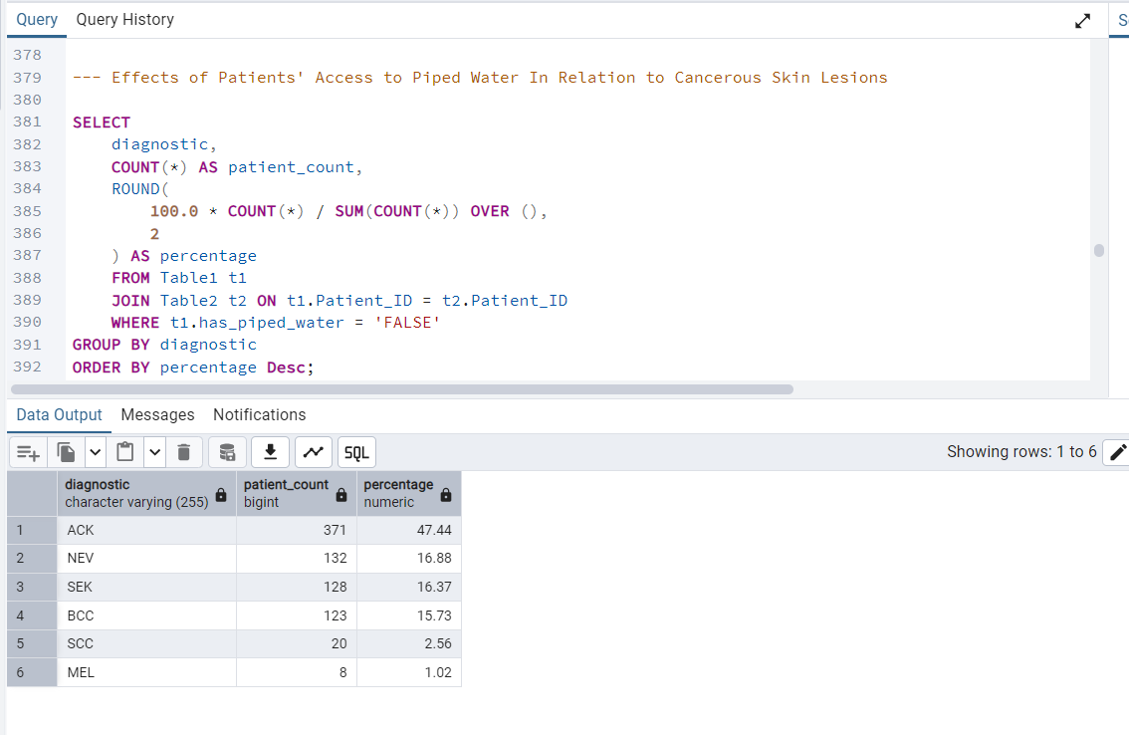

Slide 33
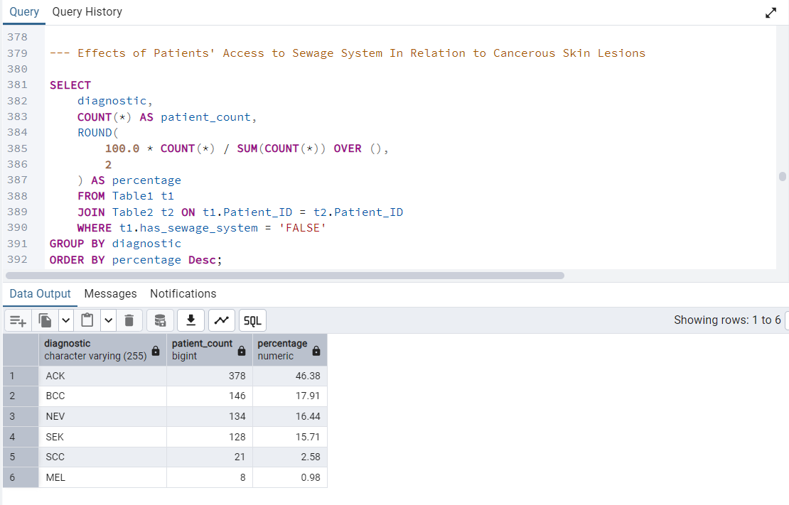

Slide 34
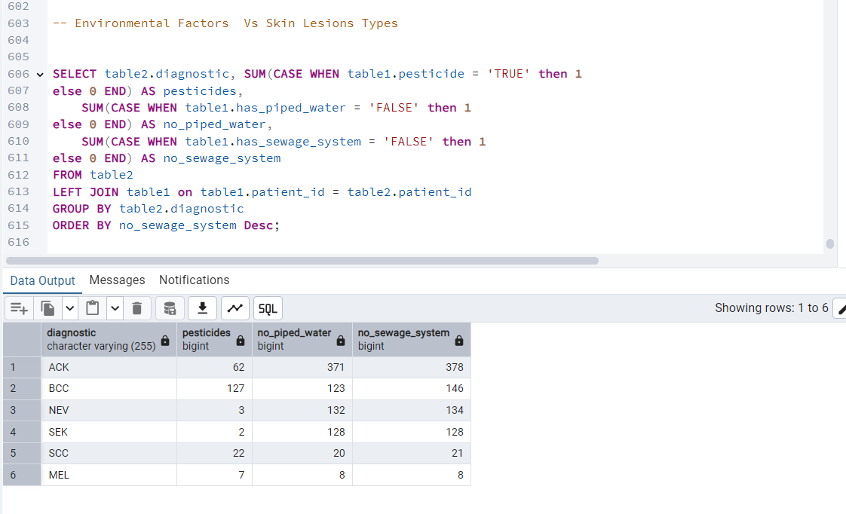

Slide 35
Lesion Characteristics To Different Types of Skin Lesions
Analysis of Lesion Itches, Pain, Bleeding, Color & Size in Relation to Skin Lesion Diagnostic Types

Slide 36
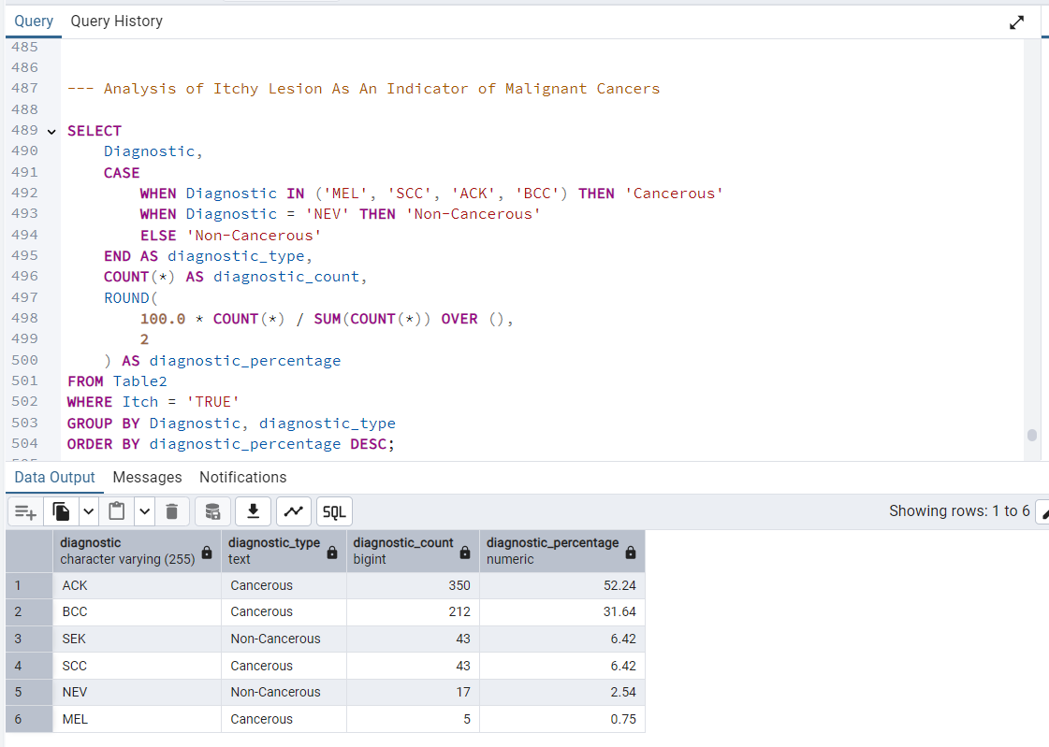

Slide 37
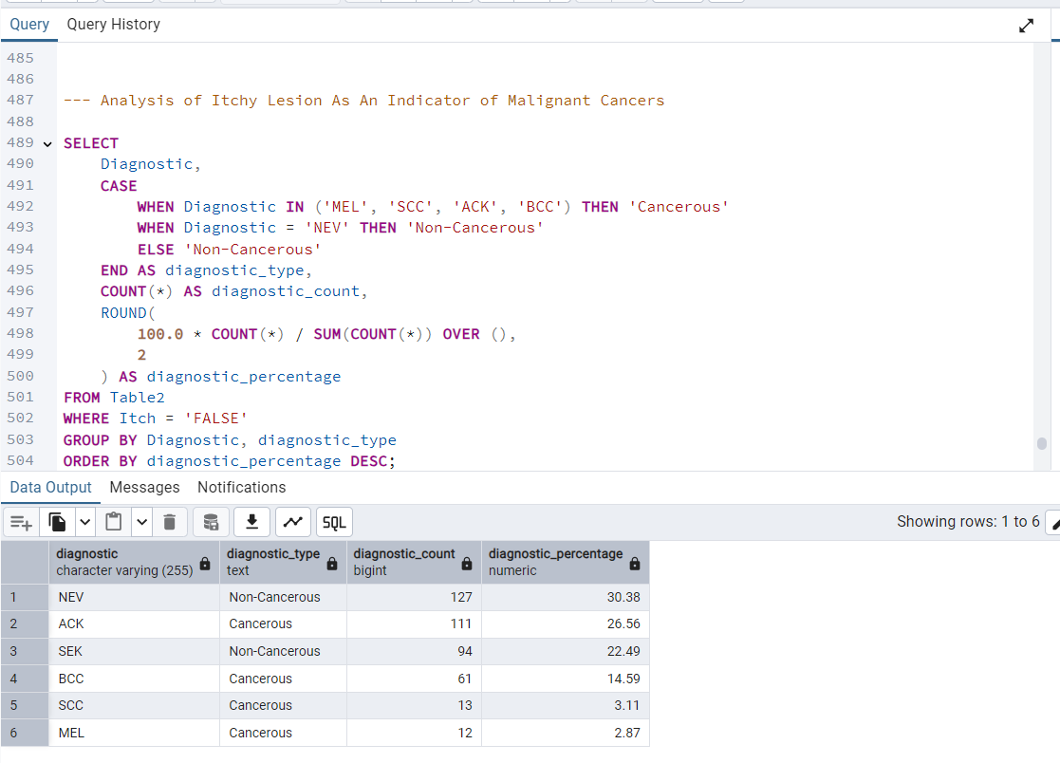

Slide 38
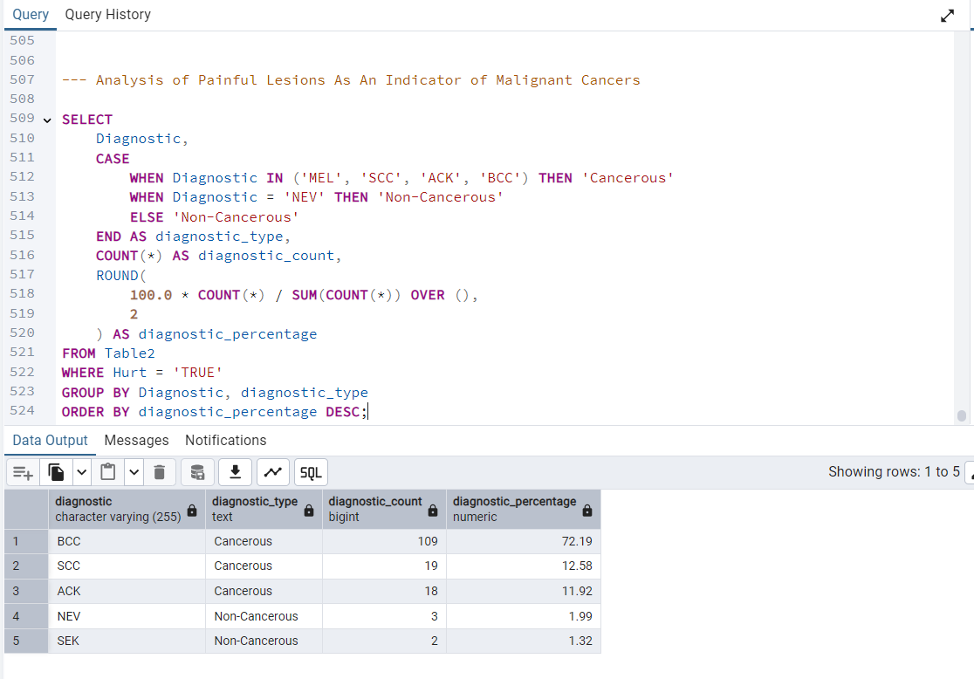

Slide 39
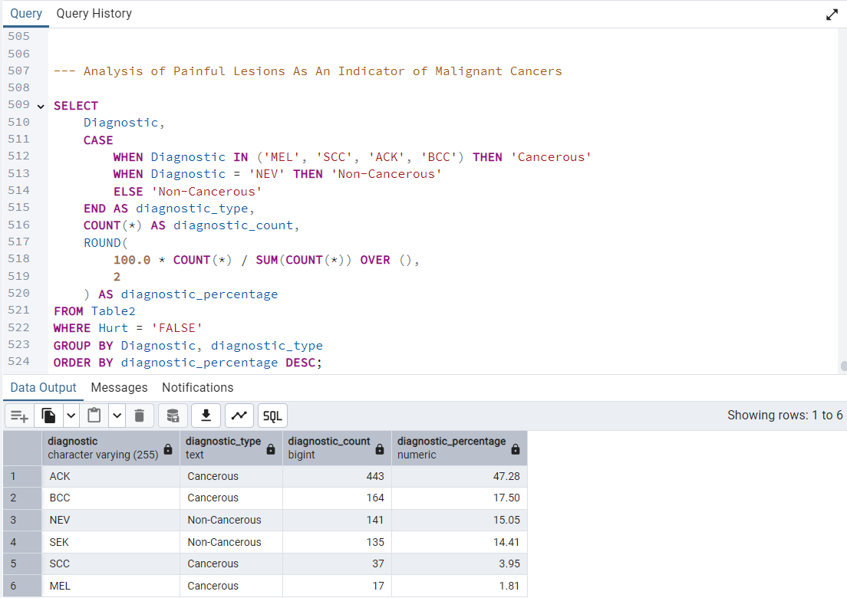

Slide 40
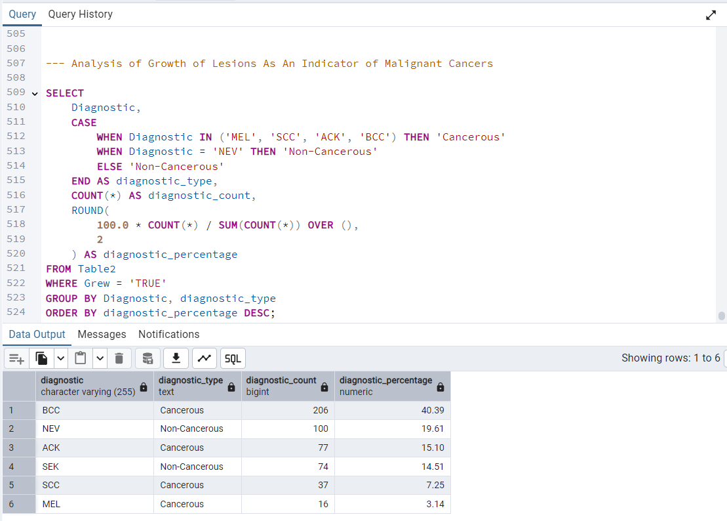

Slide 41
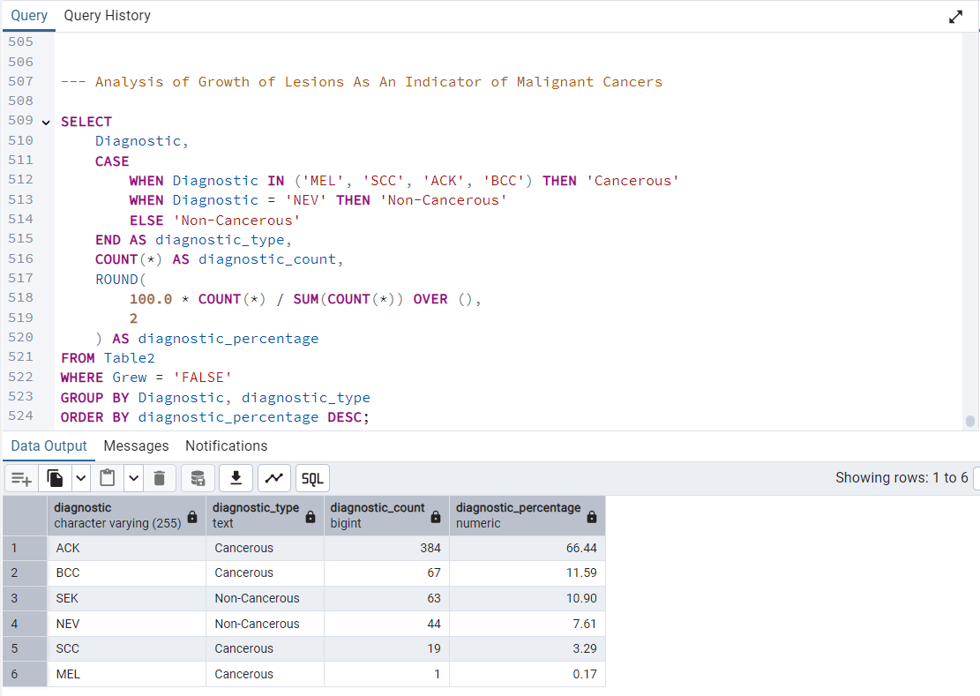

Slide 42

Early-Stage Detection and AI/Machine Learning- Based Decision Support

Slide 43
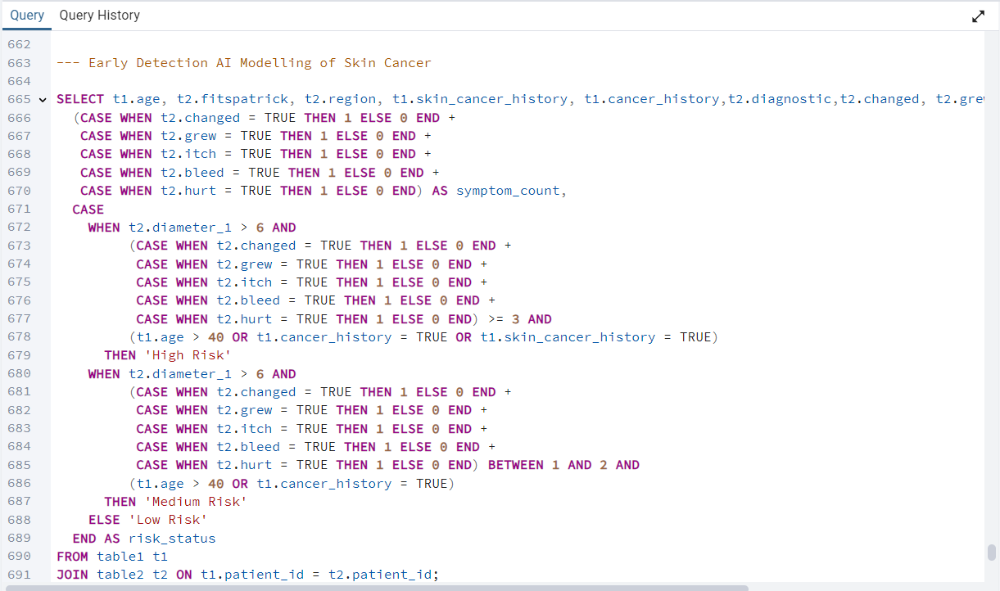

Slide 44
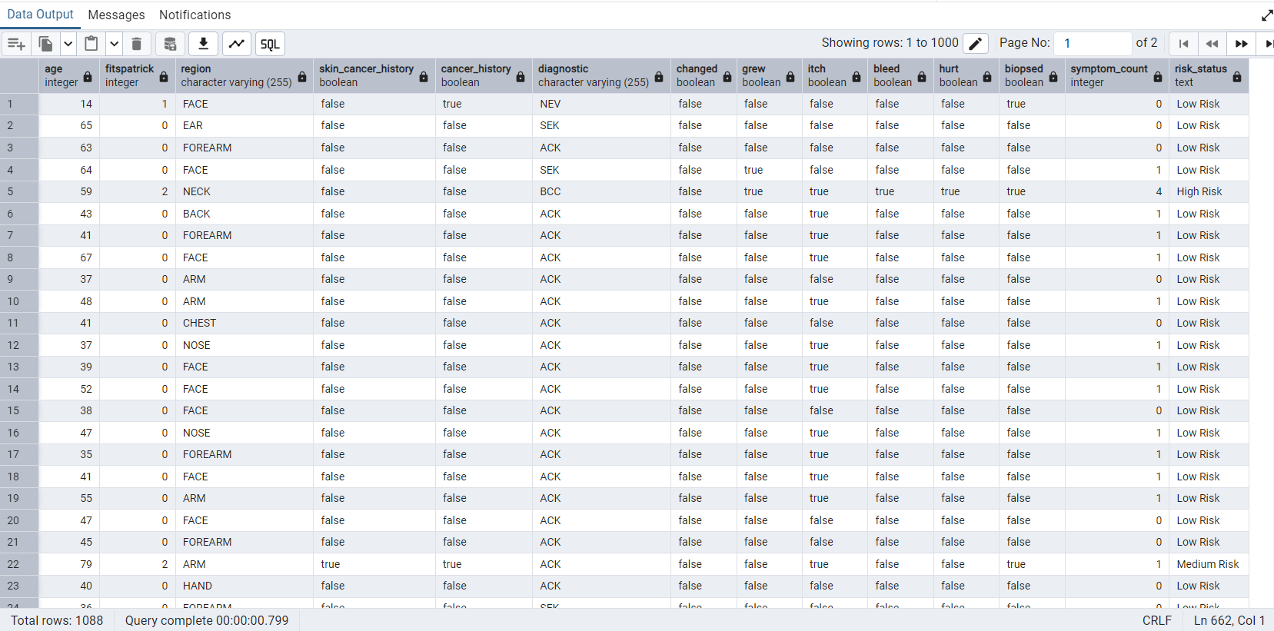

Slide 45
Summary of Findings
Lesions with three or more symptoms are strongly linked to malignancy, making them critical for early detection and AI risk scoring.
Pesticide exposure and poor sanitation significantly increase the likelihood of biopsy-confirmed and malignant skin lesions.
Males, patients over 40, and those with Fitzpatrick skin types 3–4 are more likely to develop severe or malignant lesions.
A personal or family history of cancer is a strong risk factor for melanoma, especially when combined with age and visible symptoms.
Lesions on the head and neck, especially when painful, are more frequently confirmed as malignant through biopsy.
Lesions that change in colour or size account for a high proportion of melanoma cases and should be prioritised in screening.

Slide 46
Recommendations
Integrate Red-Flag Symptom Rules into Clinical Triage Tools Use combinations like lesion size > 6mm with ≥3 symptoms (bleed, hurt, change, etc.) to flag high-risk cases for immediate review.
Prioritise Surveillance for High-Risk Groups Target patients with skin cancer history, age > 40, and confirmed family history for regular dermatological checks.
Customise AI Models with Demographic & Environmental Data Train ML models using variables like Fitzpatrick skin type, gender, pesticide exposure, and lack of sewage/piped water access, all shown to correlate with cancer severity.
Improve Diagnostic Awareness in Underserved Areas Findings show higher percentages of malignant lesions in patients without sewage systems. Public health campaigns should prioritise these regions.
Use Symptom Clustering for Pre-Consult Screening Lesions exhibiting multiple symptoms (pain, growth, colour change, elevation, bleeding) should automatically escalate during triage or telederm consultations.
Recommend Clinical Validation of AI Risk Labels Labels such as “High Risk,” “Medium Risk,” and “Low Risk” based on SQL logic should be evaluated by dermatologists for clinical adoption.

